Slide 1

Morse Code
Jonathan Chua

Slide 2
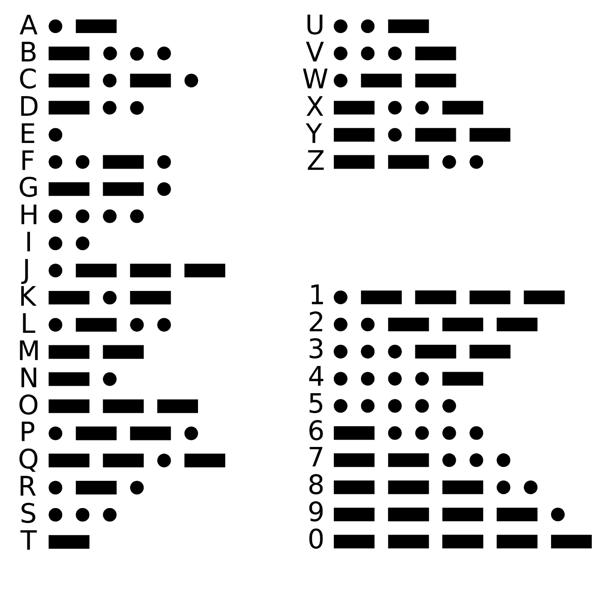
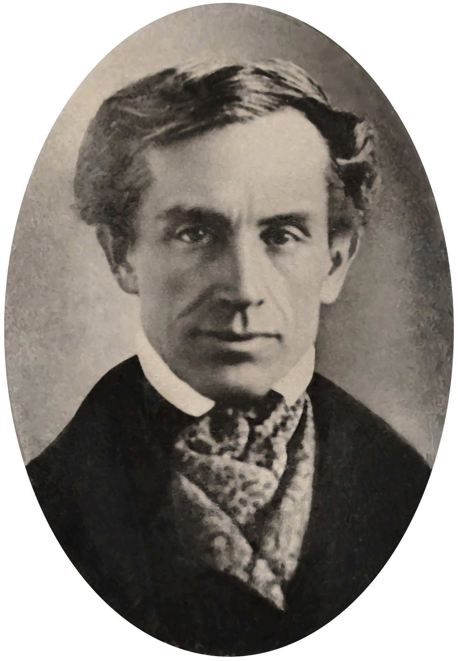
What is morse code?
Morse code is a method of transmitting text information named after Samuel Morse.

Slide 3
Activity 1
Teacher’s Code: https://makecode.microbit.org/_JpLEExA5dML0
Students’ Code: https://makecode.microbit.org/_Drf2D73jyFg8
Download and flash it on the Micro:Bit!
Button Control A: ● B: ‒ A+B: // end of message
Flash the map
Using the micro:bit, use morse code to send over coordinates

Slide 4
Story
The prisoner has escaped from the prison at coordinates N6! He is sending his position so that he can hop on his escape car.
You have intercepted his message to his abettor! Decipher the code to help the police apprehend him!
Bonus:
The prisoner has changed his location! Catch him before he runs away!

Slide 5
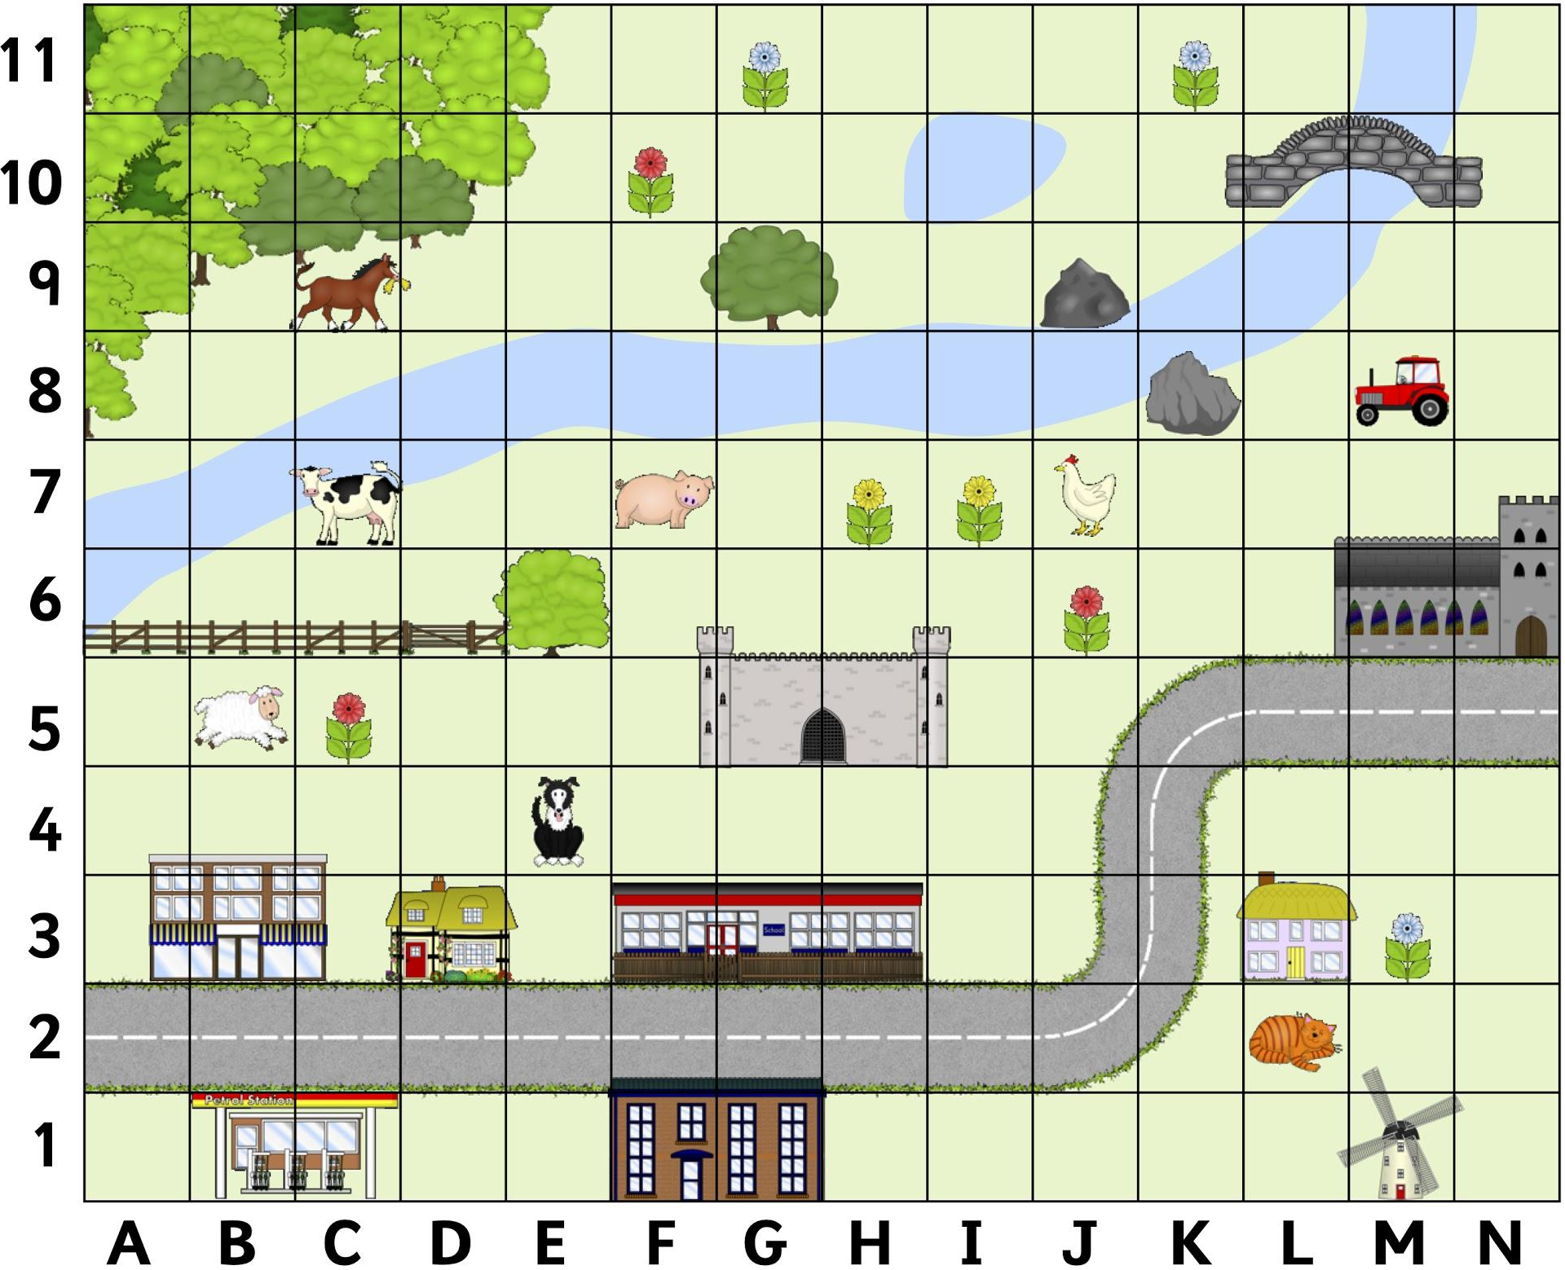

Slide 6
Activity 2
Get students to change the radio channel. Create the Morse Code Sender as shown. Send message to their friends via the micro:bit.
What else can the radio function be used for?
What can be done to improve the Micro:Bit for Morse Code?

Slide 7
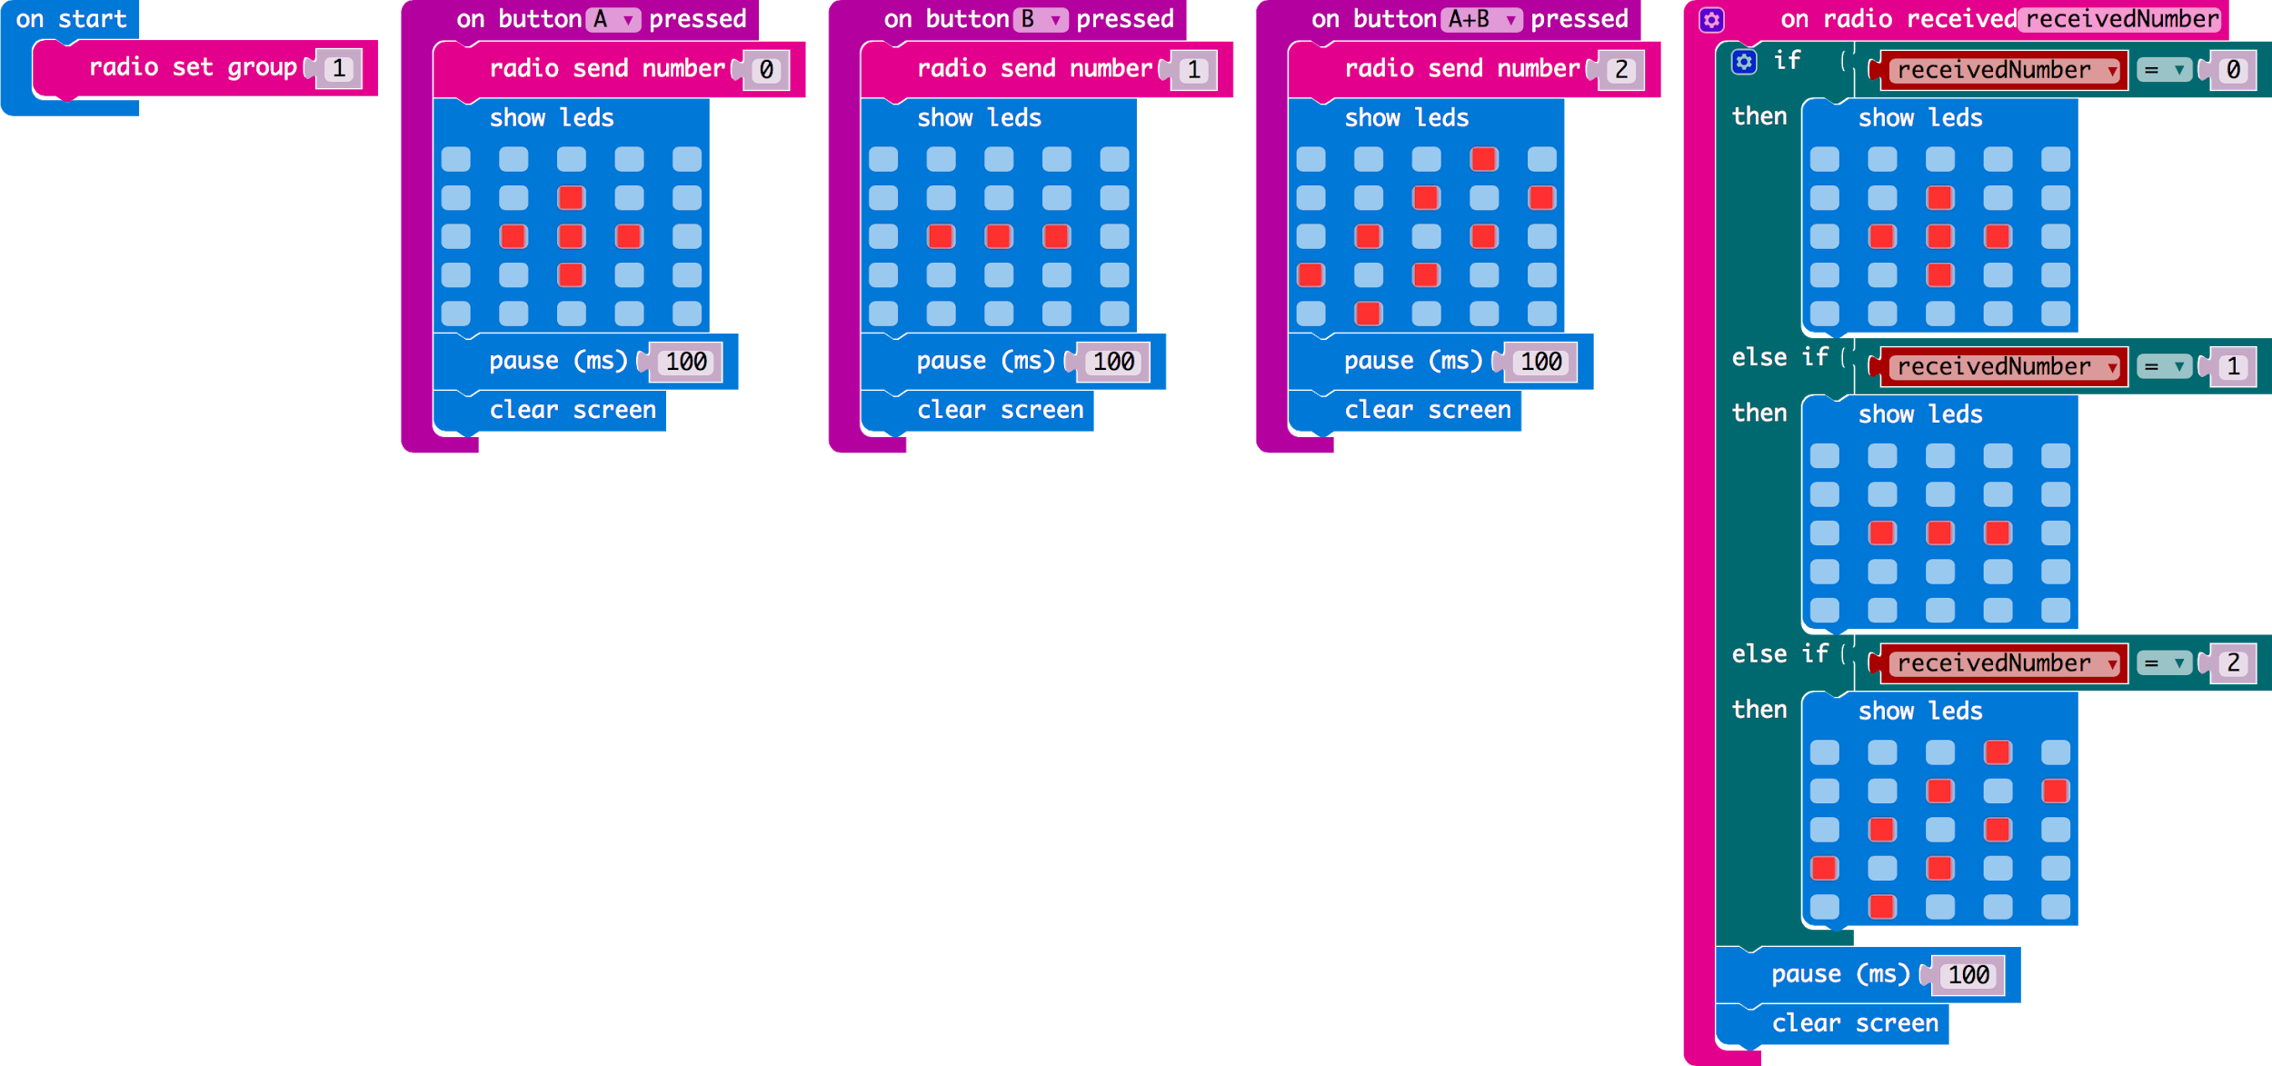
Send & Receive

Slide 8
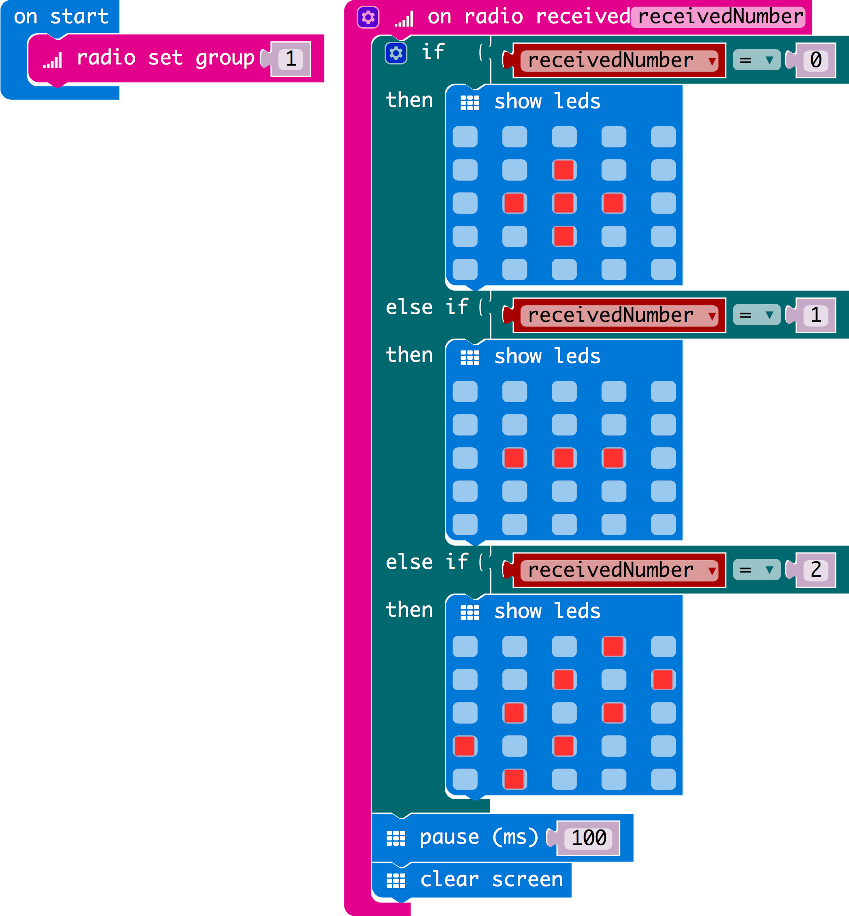
Receive only

Slide 9
Credits
http://www.sparklebox.co.uk/previews/10401-10425/sb10417-coordinates-map.html

